Slide 1

Divide-and-conquer paradigm
Divide-and-conquer.
・Divide up problem into several subproblems.
・Solve each subproblem recursively.
・Combine solutions to subproblems into overall solution.
Most common usage.
・Divide problem of size n into two subproblems of size n / 2 in linear time.
・Solve two subproblems recursively.
・Combine two solutions into overall solution in linear time.
Consequence.
・Brute force: Θ(n²).
・Divide-and-conquer: Θ(n log n).
attributed to Julius Caesar
2

Slide 2
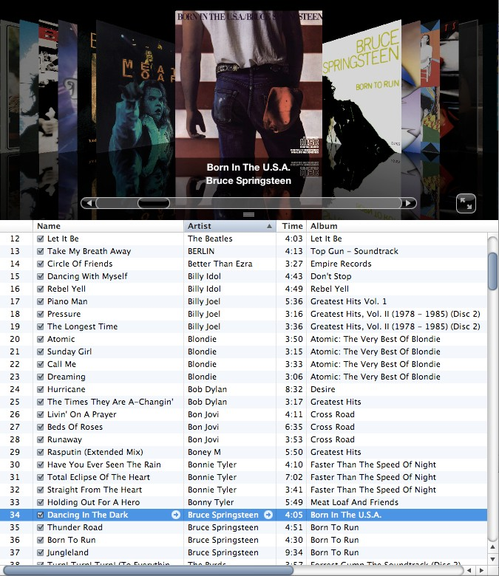
Sorting problem
Problem. Given a list of n elements from a totally-ordered universe, rearrange them in ascending order.
4

Slide 3
Sorting applications
Obvious applications.
・Organize an MP3 library.
・Display Google PageRank results.
・List RSS news items in reverse chronological order.
Some problems become easier once elements are sorted.
・Identify statistical outliers.
・Binary search in a database.
・Remove duplicates in a mailing list.
Non-obvious applications.
・Convex hull.
・Closest pair of points.
・Interval scheduling / interval partitioning.
・Minimum spanning trees (Kruskal's algorithm).
・Scheduling to minimize maximum lateness or average completion time.
・...
5

Slide 4
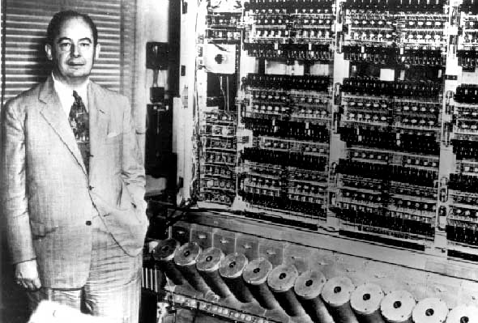
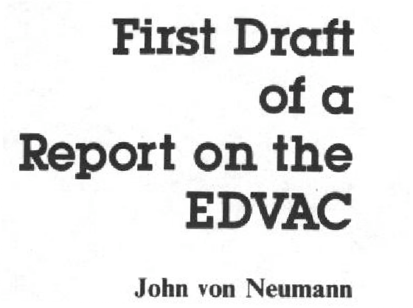
Mergesort
・Recursively sort left half.
・Recursively sort right half.
・Merge two halves to make sorted whole.
input
A | L | G | O | R | I | T | H | M | S
sort left half
A | G | L | O | R
I | T | H | M | S
sort right half
A | G | L | O | R
H | I | M | S | T
merge results
A | G | H | I | L | M | O | R | S | T

Slide 5

Merging
Goal. Combine two sorted lists A and B into a sorted whole C.
・Scan A and B from left to right.
・Compare ai and bj.
・If ai ≤ bj, append ai to C (no larger than any remaining element in B).
・If ai
> bj, append bj to C (smaller than every remaining element in A).
sorted list A
sorted list B
3 | 7 | 10 | ai | 18
2 | 11 | bj | 17 | 23
5
2
merge to form sorted list C
2 | 3 | 7 | 10 | 11

Slide 6
Challenge
Break into teams of 3, and draw out the Merge Sort recursion tree.
We will determine a recurrence from it

Slide 7
A useful recurrence relation
Def. T (n) = max number of compares to mergesort a list of size ≤ n. Note. T (n) is monotone nondecreasing.
Mergesort recurrence.
T(n) ≤
0 |  |  |  | if n = 1
T ( ⎡⎡n / 2⎤⎤ ) | + | T ( ⎣⎣n / 2⎦⎦ ) | + n | otherwise
Solution. T (n) is O(n log₂ n).
Assorted proofs. We describe several ways to prove this recurrence. Initially we assume n is a power of 2 and replace ≤ with =.

Slide 8
Divide-and-conquer recurrence: proof by recursion tree
Proposition.
If T (n) satisfies the following recurrence, then T (n) = n log2 n.
0
2 T (n / 2) + n
if n = 1 otherwise
assuming n is a power of 2
T(n) =
Pf 1.
T (n)
n
= n
T (n / 2)
T (n / 2)
2 (n/2)
= n
T (n / 4)
T (n / 4)
T (n / 4)
T (n / 4)
4 (n/4)
= n
log 2 n
T (n / 8)
T (n / 8)
T (n / 8)
T (n / 8)
T (n / 8)
T (n / 8)
T (n / 8)
T (n / 8)
8 (n/8)
= n
⋮
⋮
T(n) = n lg n
9

Slide 9
Proof by induction
Proposition. If T (n) satisfies the following recurrence, then T (n) = n log2 n.
0
2 T (n / 2) + n
if n = 1 otherwise
assuming n is a power of 2
T(n) =
Pf 2. [by induction on n]
・Base case: when n = 1, T(1) = 0.
・Inductive hypothesis: assume T(n) = n log₂ n.
・Goal: show that T(2n) = 2n log₂ (2n).
T(2n) = 2 T(n) + 2n
= 2 n log2 n + 2n
= 2 n (log2 (2n) – 1) + 2n
= 2 n log2 (2n). ▪

Slide 10
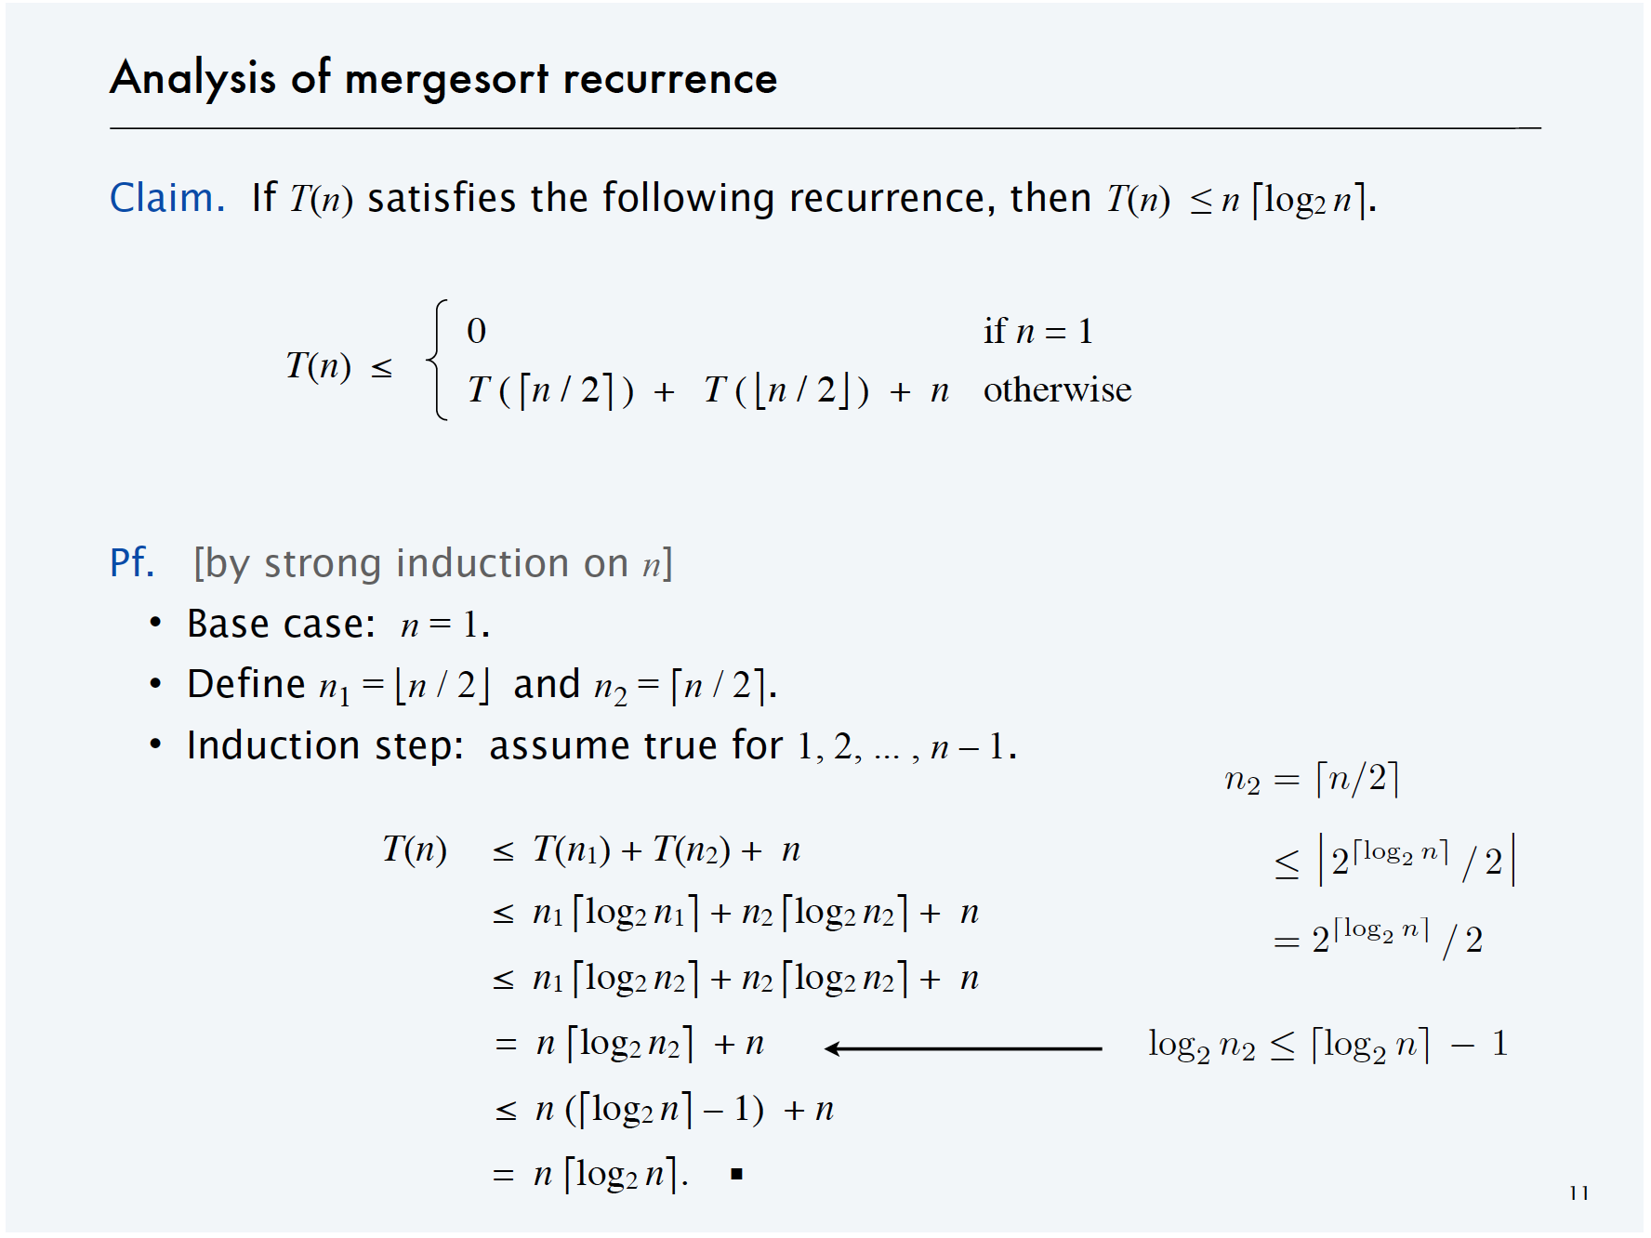
Analysis of mergesort recurrence

Slide 11
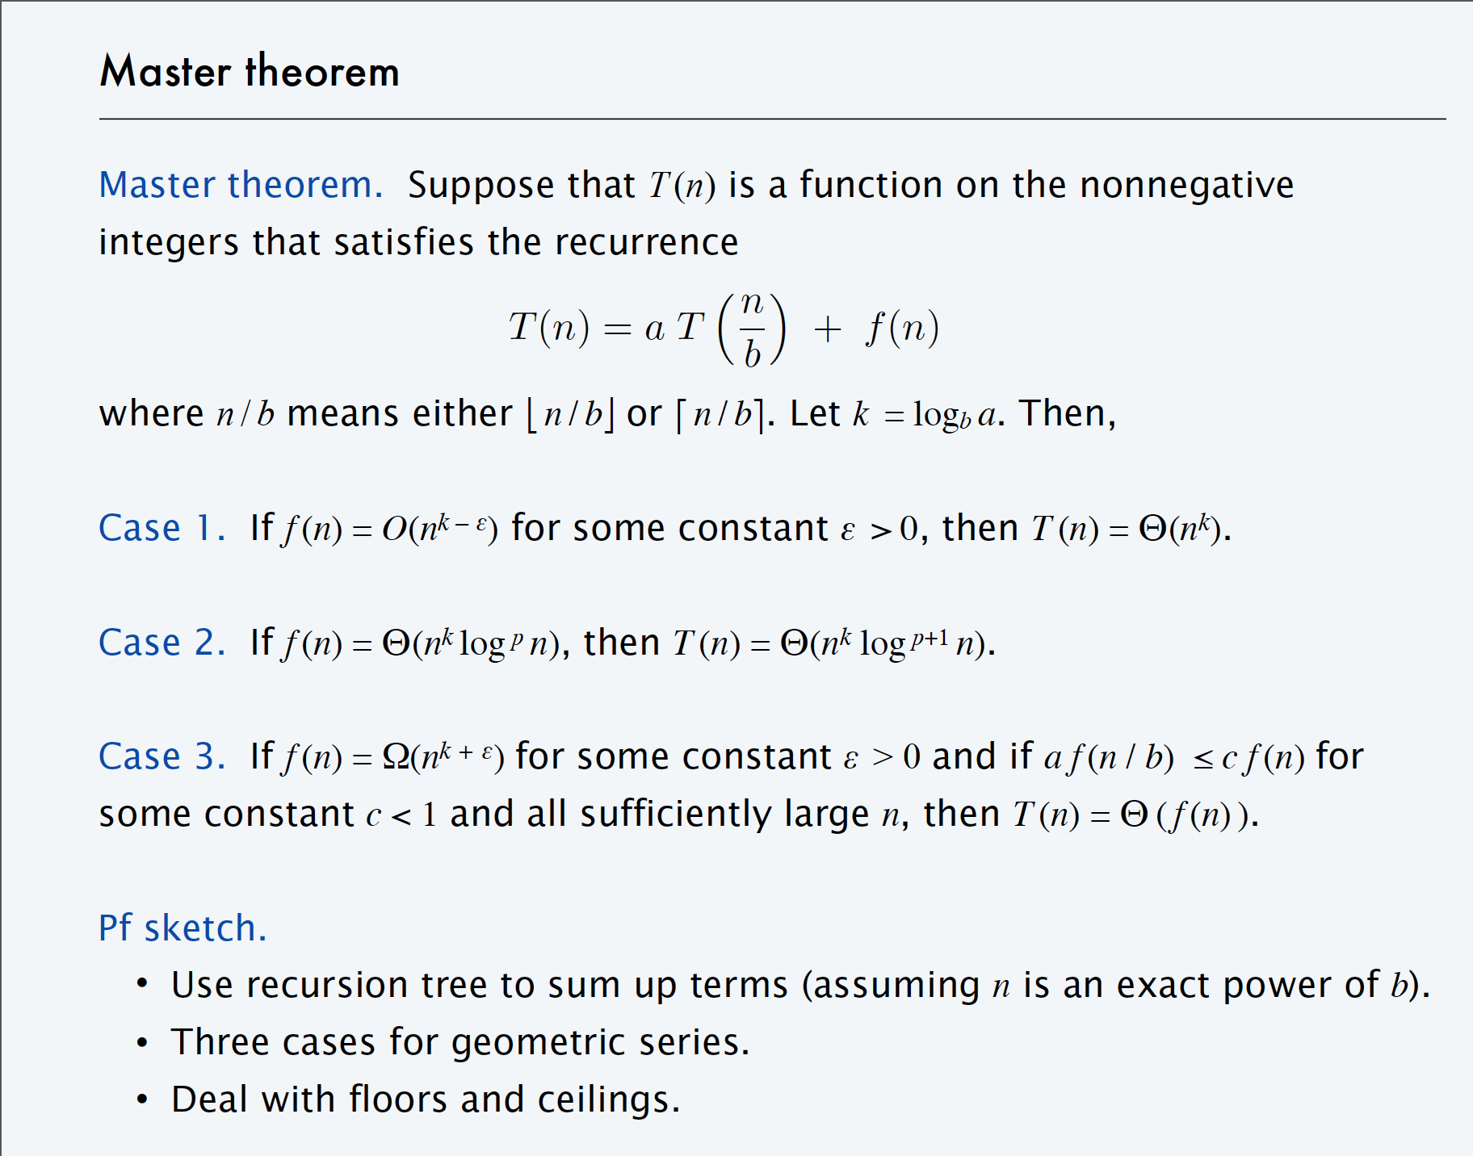

Slide 12
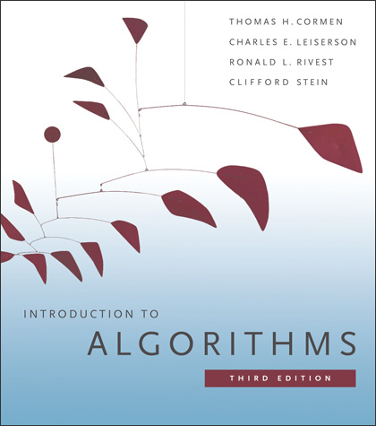
DIVIDE AND CONQUER II
master theorem
integer multiplication
matrix multiplication
convolution and FFT
SECTIONS 4.3-4.6

Slide 13
Master method
Goal.
Recipe for solving common divide-and-conquer recurrences:
T (n) = a T ^{( n \} + f (n)
b
Terms.
・a ≥ 1 is the number of subproblems.
・b > 0 is the factor by which the subproblem size decreases.
・f (n) = work to divide/merge subproblems.
Recursion tree.
・k = logb n levels.
・a^{i} = number of subproblems at level i.
・n / b^{i} = size of subproblem at level i.
3

Slide 14
Case 1:
total cost dominated by cost of leaves
Ex 1. If T (n) satisfies T (n) = 3 T (n / 2) + n, with T (1) = 1, then T (n) = Θ(n^{lg 3}).
T (n)
n
T (n / 2)
T (n / 2)
T (n / 2)
3 (n / 2)
T (n / 4)
T (n / 4)
T (n / 4)
T (n / 4)
T (n / 4)
T (n / 4)
T (n / 4)
T (n / 4)
T (n / 4)
3² (n / 2²)
⋮
log2 n
3^{i} (n / 2^{i})
⋮
₃log₂ n_{(n/ 2}log₂ n₎
...
T (1) T (1) T (1) T (1) T (1) T (1) T (1) T (1) T (1) T (1)
T (1) T (1) T (1)
₃log₂ n _{= n}log₂ 3
1+log₂ n
r = 3 / 2 > 1
2 3 log n
r - 1
log 3
T (n) = (1 + r + r + r + ... + r
2
) n
=
n
= 3n
2
2n
r 1
4

Slide 15
Exercise 1, Master Theorem
Master theorem.
Suppose that T (n) is a function on the nonnegative
integers that satisfies the recurrence
T (n) = a T ^{( n \} + f (n)
b
where n / b means either ⎣⎣ n / b⎦⎦ or ⎡⎡ n / b⎤⎤.
Let k = logb a. Then,
Case 1.
If f (n) = O(n^{k – ε}) for some constant ε > 0, then T (n) = Θ(n^{k}).
Ex. T (n) = 3 T(n / 2) + n.

Slide 16
Case 2:
total cost evenly distributed among levels
Ex 2.
If T (n) satisfies T (n) = 2 T (n / 2) + n, with T (1) = 1, then T (n) = Θ(n log n).
T (n)
n
T (n / 2)
T (n / 2)
2 (n / 2)
T (n / 4)
T (n / 4)
T (n / 4)
T (n / 4)
2² (n / 2²)
log2 n
T (n / 8)
T (n / 8)
T (n / 8)
T (n / 8)
T (n / 8)
T (n / 8)
T (n / 8)
T (n / 8)
2³ (n / 2³)
⋮
⋮
...
T (1) T (1) T (1) T (1) T (1) T (1) T (1) T (1) T (1) T (1)
T (1) T (1) T (1)
n (1)
₂log₂ n _{= n}
r = 1
T (n) = (1 + r + r² + r³ + ... + r^{log2 n}) n
= n (log2 n + 1)
5

Slide 17
Exercise 2, Master Theorem
Master theorem.
Suppose that T (n) is a function on the nonnegative
integers that satisfies the recurrence
T (n) = a T ^{( n \} + f (n)
b
where n / b means either ⎣⎣ n / b⎦⎦ or ⎡⎡ n / b⎤⎤. Let k = logb a. Then,
Case 2.
If f (n) = Θ(n^{k} log ^{p} n), then T (n) = Θ(n^{k} log ^{p+1} n).
Ex. T (n) = 2 T(n / 2) + Θ(n log n).

Slide 18
Case 3:
total cost dominated by cost of root
Ex 3. If T (n) satisfies T (n) = 3 T (n / 4) + n⁵, with T (1) = 1, then T (n) = Θ(n⁵).
T (n)
_{n}5
T (n / 4)
T (n / 4)
T (n / 4)
3 (n / 4)⁵
T (n / 16)
T (n / 16)
T (n / 16)
T (n / 16)
T (n / 16)
T (n / 16) T (n / 16)
T (n / 16)
T (n / 16)
3² (n / 4²)⁵
⋮
log4 n
3^{i} (n / 4^{i})⁵
⋮
₃log₄ n_{(n/4}log₄ n₎5
...
T (1) T (1) T (1) T (1) T (1) T (1) T (1) T (1) T (1) T (1)
T (1) T (1) T (1)
₃log₄ n _{= n}log₄ 3
r = 3 / 4⁵ < 1
_{n}5
≤ T (n) ≤ (1 + r + r ² + r ³ + … ) n⁵ ≤
1
_{n}5
1 – r
6

Slide 19
Exercise 3, Master Theorem
Master theorem.
Suppose that T (n) is a function on the nonnegative
integers that satisfies the recurrence
T (n) = a T ^{( n \} + f (n)
b
where n / b means either ⎣⎣ n / b⎦⎦ or ⎡⎡ n / b⎤⎤. Let k = logb a. Then,
regularity condition holds if f(n) = Θ(n^{k + ε})
Case 3.
If f (n) = Ω(n^{k + ε}) for some constant ε > 0 and if a f (n / b) ≤ c f (n) for
some constant c < 1 and all sufficiently large n, then T (n) = Θ ( f (n) ).
Ex. T (n) = 3 T(n / 4) + n⁵.

Slide 20
Master theorem
Master theorem.
Suppose that T (n) is a function on the nonnegative
integers that satisfies the recurrence
T (n) = a T ^{( n \} + f (n)
b
where n / b means either ⎣⎣ n / b⎦⎦ or ⎡⎡ n / b⎤⎤.
Let k = logb a. Then,
Case 1.
If f (n) = O(n^{k – ε}) for some constant ε > 0, then T (n) = Θ(n^{k}).
Ex. T (n) = 3 T(n / 2) + n.
・a = 3, b = 2, f (n) = n,
・T (n) = Θ(n^{lg 3}).
k = log2 3.

Slide 21
Master theorem
Master theorem.
Suppose that T (n) is a function on the nonnegative
integers that satisfies the recurrence
T (n) = a T ^{( n \} + f (n)
b
where n / b means either ⎣⎣ n / b⎦⎦ or ⎡⎡ n / b⎤⎤. Let k = logb a. Then,
Case 2.
If f (n) = Θ(n^{k} log ^{p} n), then T (n) = Θ(n^{k} log ^{p+1} n).
Ex. T (n) = 2 T(n / 2) + Θ(n log n).
・a = 2, b = 2, f (n) = 17 n,
・T (n) = Θ(n log² n).
k = log2 2 = 1, p = 1.

Slide 22
Master theorem
Master theorem.
Suppose that T (n) is a function on the nonnegative
integers that satisfies the recurrence
T (n) = a T ^{( n \} + f (n)
b
where n / b means either ⎣⎣ n / b⎦⎦ or ⎡⎡ n / b⎤⎤. Let k = logb a. Then,
regularity condition holds if f(n) = Θ(n^{k + ε})
Case 3.
If f (n) = Ω(n^{k + ε}) for some constant ε > 0 and if a f (n / b) ≤ c f (n) for
some constant c < 1 and all sufficiently large n, then T (n) = Θ ( f (n) ).
Ex. T (n) = 3 T(n / 4) + n⁵.
・a = 3, b = 4, f (n) = n⁵, k = log4 3.
・T (n) = Θ(n⁵).

